Slide 1
Spatial MS SQL Server 2012
INFS7205 - Assignment 2
Group 5
Andres Felipe Aguirre Quintero
Abdullah M. Albarrak
Mochamad Ndaru Purnomo Sidi
Romaan Khadeer Ahmed

Slide 2
Outline
Introduction to SQL Server 2012
Support for Spatial Data Types
DDL and DML for Spatial Data Types
Spatial Functions
Spatial Index
Demonstration

Slide 3

Introduction to SQL Server
Launched in March 6, 2012
Native support for spatial data types in SQL Server 2008
Improved support for spatial databases

Slide 4
Support for Spatial Data Types
Two types:
Geometry:
Euclidian Data (i.e., flat-earth data).
Two dimensional representation.
Geography:
Ellipsoidal Data (i.e., round earth).
Latitude and longitude to represent points or objects.

Slide 5
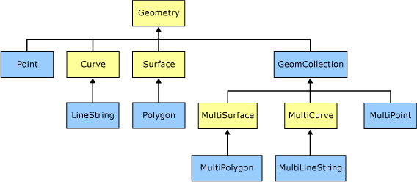
Geometry Hierarchy

Slide 6
DDL and DML for Spatial Data Types
Create LandBlock table with "geometry" data type.
Shape types are not specified on table creation
create table LandBlock (area geometry)
Insert geometry values:
Polygon, circularstring, curvepolygon, linestring, point.
insert into LandBlock (area)
values (
geometry::STGeomFromText(
'POLYGON ((0 22, 0 29, 15 22, 0 22))'
, 0))

Slide 7
Spatial Functions
Spatial Function | Syntax | Returned Value
STIntersects: Checks if the calling geometry intersects with another geometry | STIntersects( geometry ) | Returns 1 if true, else returns 0
STContains: Checks if the calling geometry contains another geometry | STContains( geometry ) | Returns 1 if true, else returns 0
STArea: returns the area of the calling geometry. | STArea() | Returns the area in square meters.
STDistance: returns the smallest distance between the calling geometry and the other geometry. | STDistance ( geometry) | Returns the distance in meters.

Slide 8
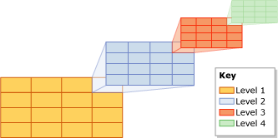
Spatial Index
Spatial indexes are built using B-trees
The index creation process decomposes the space into four-level grid hierarchy
Grid density
Tessellation
Query needs to specify which spatial index to use

Slide 9
Now, the demonstration

